Slide 1
Databases and SQL for Data Science with Python

Slide 2
Why SQL is Essential for Data Scientists?
SQL = The Key to Access and Prepare Your Data 🔑
Data Lives in Databases Most real-world data is stored in relational databases (MySQL, PostgreSQL, SQL Server).
SQL is the Language to Talk to Data Retrieve only the data you need using filtering, sorting, grouping, and joining.
Prepare Data at the Source Clean, filter, and merge data before importing it into Python, R, or BI tools.
Understand Data Structure Learn table relationships, data types, and data quality directly from the database.
Highly Demanded Skill Most Data Science job descriptions list SQL as a core requirement.
"Before you analyze data, you must know how to access it." – IBM Data Science Approach

Slide 3
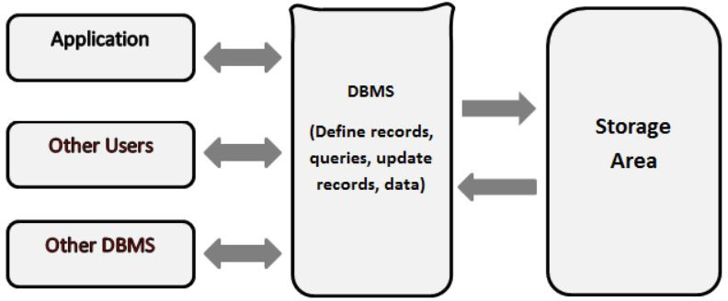
What are Databases?
A database is an organized collection of data, generally stored and accessed electronically from a computer system. It supports the storage and manipulation of data.
In other words, databases are used by an organization as a method of storing, managing and retrieving information.

Slide 4
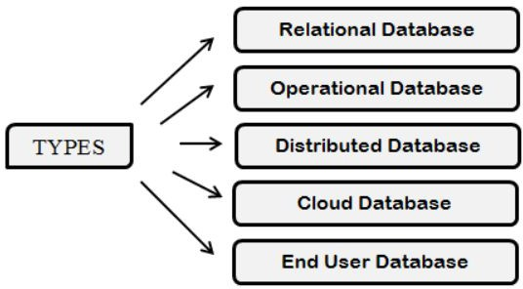
Types of Databases
Depending upon the usage requirements, there are following types of databases available in the market:
Centralized database
Distributed database
Personal database
End-user database
Commercial database
NoSQL database
Operational database
Relational database
Cloud database
Object-oriented database
Graph database Here is a detailed article on, Types of Database Management Systems.

Slide 5
Advantages of using Databases
There are many advantages of databases
Reduced data redundancy
Reduced updating errors and increased consistency
Greater data integrity and independence from application programs
Improved data access to users through the use of host and query languages
Improved data security
Reduced data entry, storage, and retrieval costs

Slide 6
Disadvantages of using Databases
There are many disadvantages of databases
Although databases allow businesses to store and access data efﬁciently, they also have certain disadvantages
Complexity
Cost
Security
Compatibility

Slide 7




Some examples of Databases
Some of the most popular databases are
Oracle Database
Sybase
MySQL
IBM db2

Slide 8
What is SQL?
SQL (Structured Query Language): Is used to perform operations on the records stored in the database, such as updating records, inserting records, deleting records, creating and modifying database tables, views, etc.
SQL is not a database system, but it is a query language.

Slide 9
Database Schema
A schema is a group of related objects in a database. There is
one owner of a schema who has access to manipulate the structure of any object in the schema. A schema does not represent a person, although the schema is associated with a user that resides in the database.
Notes:
‹#›
Schema Definition

Slide 10
Database Schema and Database instance
Database Schema
Database schema is the structure of a database, refers to the organization of data as a blueprint that demonstrates how the database is constructed.
So, a database schema describes how the data may relate to other tables or other data models. However, the schema does not actually contain data.
Database instance
Database instance is a snapshot of data in a database at a single moment in time . It contains all the properties that the schema describes as data values.
Since database instances are just a snapshot at a given moment, they’re likely to change over time, unlike database schemas.

Slide 11
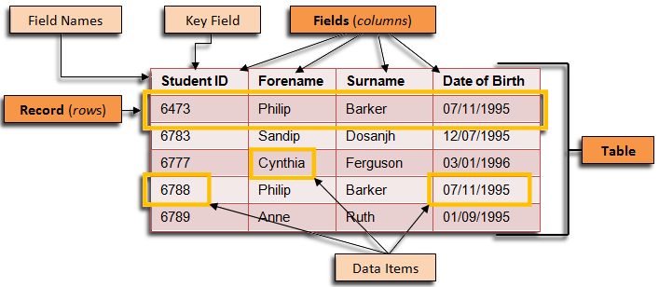

Slide 12
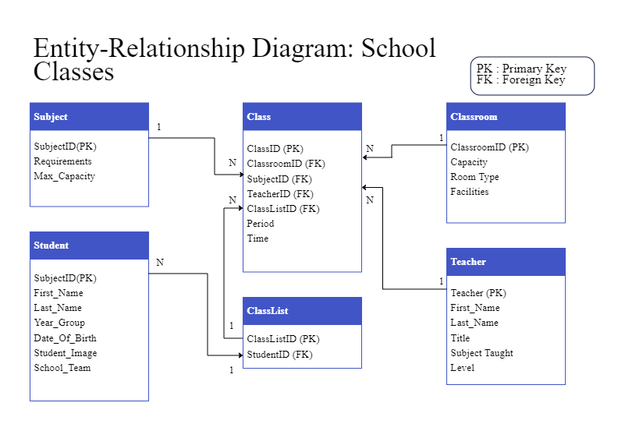
StudentID (PK)

Slide 13
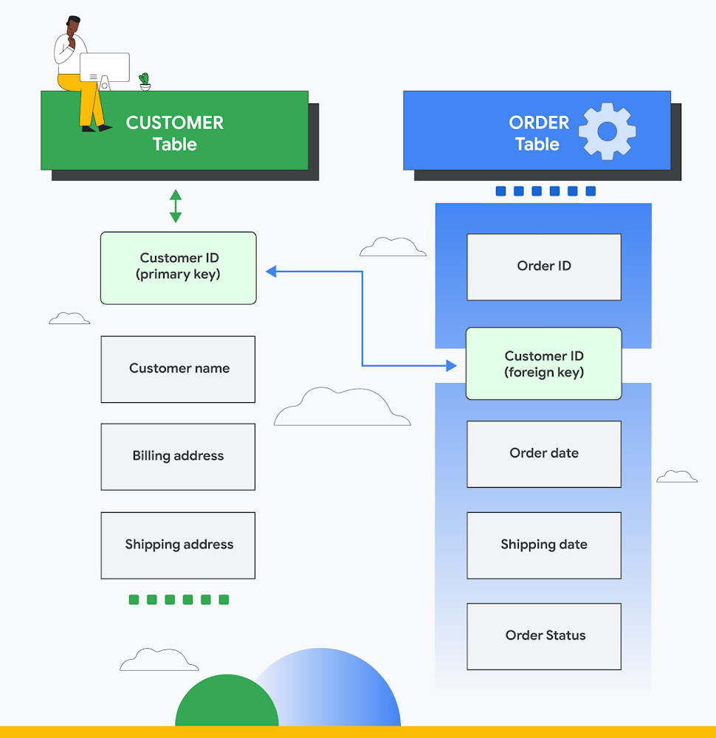

Slide 14
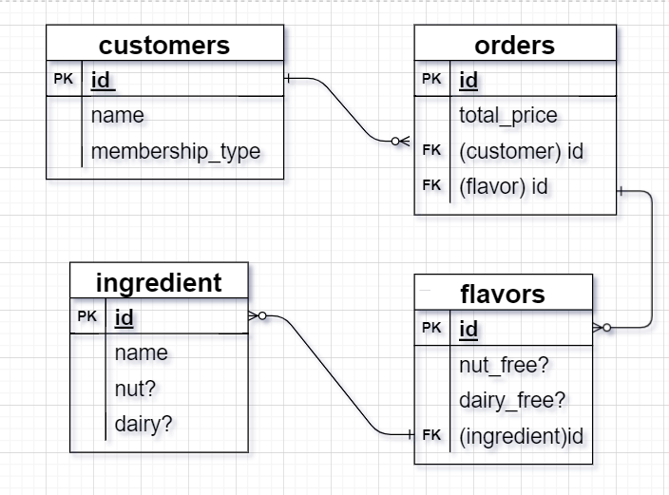

Slide 15
Database Constraints
Primary Key ( Not Null + Unique)
Not Null
Unique Key
Referential Integrity ( Foreign key FK )
Check
Notes:
‹#›

Slide 16
Data types
A data type determines the type of data that can be stored in a
database column. The most commonly used data types are:
1. Alphanumeric: data types used to store characters, numbers, special characters, or nearly any combination.
2. Numeric
3. Date and Time
Notes:
‹#›

Slide 17
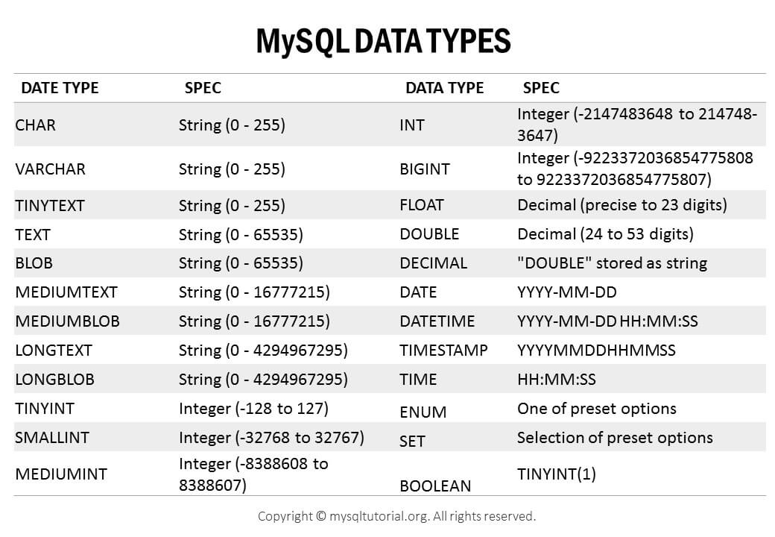

Slide 18
Primary key: - A field in a table that uniquely identifies each rows in a database table. - Primary keys must contain unique values. - A table can have only one Primary keys.
--define primary key
CREATE TABLE students(
student_id int PRIMARY KEY,
name varchar(20));

Slide 19
Foreign key: - Reference a column in another table to define the relationship between two tables. - The relationship between 2 tables matches the Primary Key in one of the tables with a Foreign Key in the second table.
--define primary key
CREATE TABLE teachers(
id int PRIMARY KEY,
teache_name varchar(30),
);
CREATE TABLE classes(
id integer PRIMARY KEY,
teacher_id int REFERENCES teachers(id), --foreign key is created
category varchar(40),
);

Slide 20
Database Transaction
A transaction is an executing program that forms a logical unit of database actions.
It includes one or more database access operations such as insert, delete and update.
The database operations that form a transaction can either be embedded within an application program or they can be specified interactively via a high-level query language such as SQL.
Notes:
‹#›

Slide 21
Database Transaction Properties
Transactions should possess several properties, often called the ACID properties:
Atomicity
Consistency
Isolation
Durability
Notes:
‹#›
■ Atomicity. A transaction is an atomic unit of processing; it should either be
performed in its entirety or not performed at all.
■ Consistency preservation. A transaction should be consistency preserving,
meaning that if it is completely executed from beginning to end without
interference from other transactions, it should take the database from one
consistent state to another.
■ Isolation. A transaction should appear as though it is being executed in isolation
from other transactions, even though many transactions are executing concurrently. That is, the execution of a transaction should not be interfered
with by any other transactions executing concurrently.
■ Durability or permanency. The changes applied to the database by a committed
transaction must persist in the database. These changes must not be
lost because of any failure

Slide 22
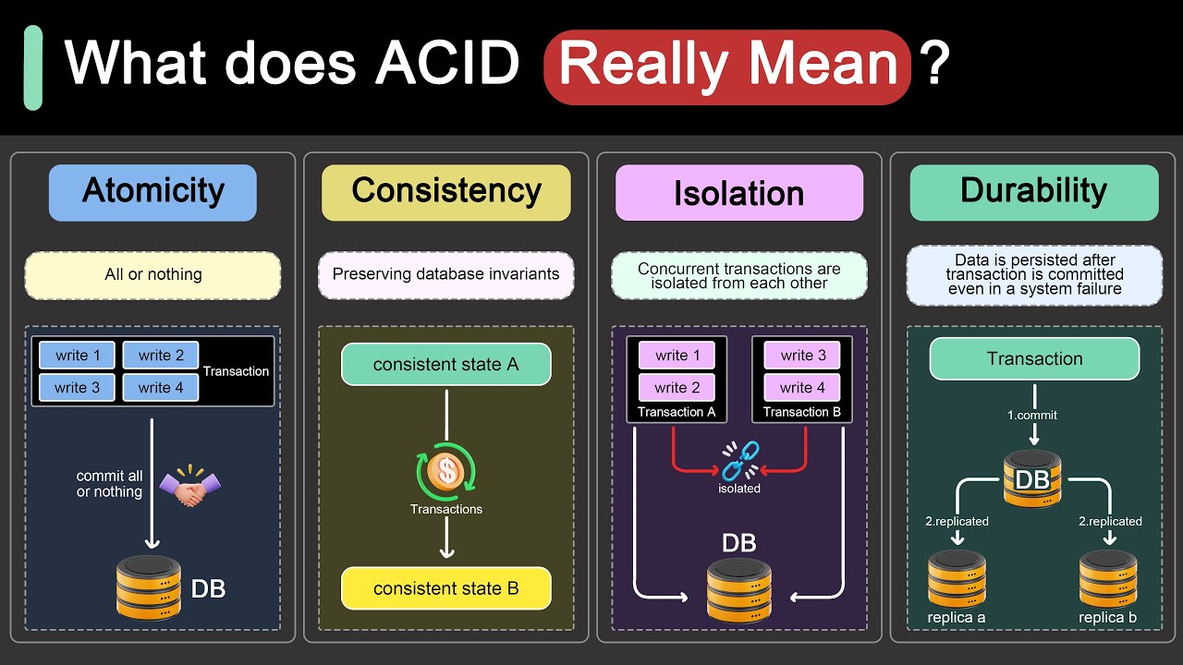

Slide 23
SQL Commands
SQL commands are instructions. It is used to communicate with the database. It is also used to perform speciﬁc tasks, functions, and queries of data.
SQL can perform various tasks like create a table, add data to tables, drop the table, modify the table, set permission for users.

Slide 24
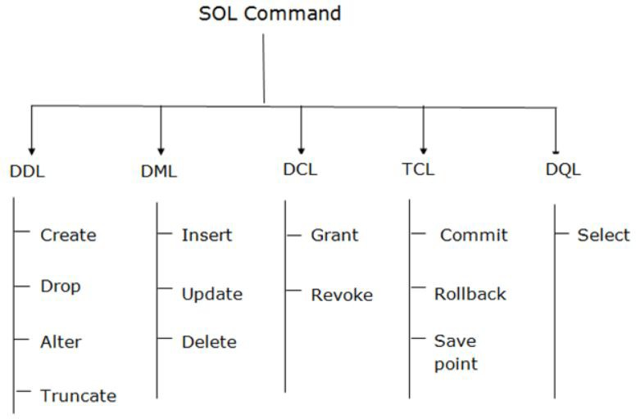
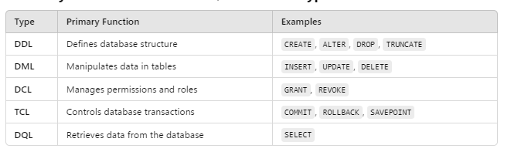
Types of SQL Commands
Data Definition Language
Data Manipulation Language
Data Control Language
Data Query Language
Transaction Control Language

Slide 25
Data Deﬁnition Language (DDL)
DDL changes the structure of the table like creating a table, deleting a table, altering a table, etc.
All the command of DDL are auto-committed that means it permanently save all the changes in the database.
Here are some commands that come under DDL:
CREATE
ALTER
DROP
TRUNCATE

Slide 26

Data Deﬁnition Language (DDL)
CREATE It is used to create a new table in the database
Example
.

Slide 27


Data Deﬁnition Language (DDL)
DROP: It is used to delete both the structure and record stored in the table.
Example
.

Slide 28
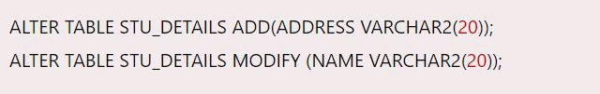
Data Deﬁnition Language (DDL)
ALTER: It is used to alter the structure of the database. This change could be either to modify the characteristics of an existing attribute or probably to add a new attribute.
Example
.

Slide 29


Data Deﬁnition Language (DDL)
TRUNCATE: It is used to delete all the rows from the table and free the space containing the table.
Example

Slide 30
Data Deﬁnition Language (DDL)
TRUNCATE: It is used to delete all the rows from the table and free the space containing the table.
Example

Slide 31
Data Manipulation Language (DML)
DML commands are used to modify the database. It is responsible for all form of changes in the database.
The command of DML is not auto-committed that means it can't permanently save all the changes in the database. They can be rollback.
Here are some commands that come under DML:
INSERT
UPDATE
DELETE

Slide 32
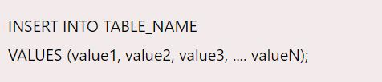

Data Manipulation Language (DML)
INSERT: The INSERT statement is a SQL query. It is used to insert data into the row of a table
Example:.

Slide 33
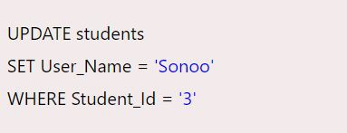
Data Manipulation Language (DML)
UPDATE: This command is used to update or modify the value of a column in the table.
Example:.

Slide 34

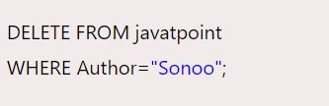
Data Manipulation Language (DML)
DELETE: It is used to remove one or more row from a table.
Example:.

Slide 35
Data Control Language (DCL)
DCL commands are used to grant and take back authority from any database user.
Here are some commands that come under DCL:
Grant
Revoke

Slide 36
Data Control Language (DCL)
Grant: It is used to give user access privileges to a database.
Example:

Slide 37
Data Control Language (DCL)
Revoke: It is used to take back permissions from the user.
Example:

Slide 38
Transaction Control Language(TCL)
TCL commands can only use with DML commands like INSERT, DELETE and UPDATE only.
These operations are automatically committed in the database that's why they cannot be used while creating tables or dropping them.
Here are some commands that come under TCL:
COMMIT
ROLLBACK
SAVEPOINT

Slide 39

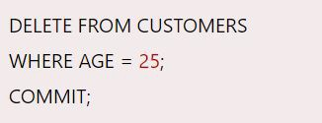
Transaction Control Language(TCL)
Commit: Commit command is used to save all the transactions to the database.
Example

Slide 40

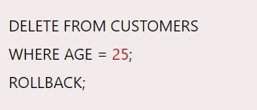
Transaction Control Language(TCL)
Rollback: Rollback command is used to undo transactions that have not already been saved to the database.
Example

Slide 41

Transaction Control Language(TCL)
SAVEPOINT: It is used to roll the transaction back to a certain point without rolling back the entire transaction.
Example
Notes:
end S1

Slide 42
MySQL VS PostgreSQL VS SQL Server
Core Idea
SQL basics are the same across systems
Core CRUD commands (SELECT, INSERT, UPDATE, DELETE) work almost the same in MySQL, PostgreSQL, and SQL Server.
Learning SQL in one system makes it easy to move to another.
Strengths of Each System
MySQL: Simple, widely used, great for learning and small-to-medium projects.
PostgreSQL: Rich advanced features (JSONB, Arrays, GIS), strong for complex data analysis.
SQL Server: Strong integration with Microsoft tools, advanced stored procedures, business analytics support.
SQL is one language, but each system has its own accent.
Master the basics first—then adapting to another system is just learning a few new words.

Slide 43
Differences Are in the Details and if u need
Main differences appear in:
Built-in Functions:
Text length → LENGTH (MySQL), CHAR_LENGTH (PostgreSQL), LEN (SQL Server)
Dates → NOW() (MySQL/PostgreSQL), GETDATE() (SQL Server)
Pagination:
LIMIT in MySQL/PostgreSQL
TOP or OFFSET…FETCH in SQL Server
Data Types: Boolean, JSON, Arrays
Auto Increment IDs:
MySQL → AUTO_INCREMENT
PostgreSQL → SERIAL or GENERATED AS IDENTITY
SQL Server → IDENTITY(1,1)
Advanced Features: Full-Text Search, Window Functions, Upsert.

Slide 44
Task XAMPP & MySQL
Install XAMPP
https://www.apachefriends.org/download.html
Run Apache and MySQL
Create Database (YourName_db)
Create 2 Table (customers,orders )
Insert 3 customers (You, Baraa, Ali )
Insert 6 orders (3 for you, 2 for Baraa,1 for Ali )

Slide 45
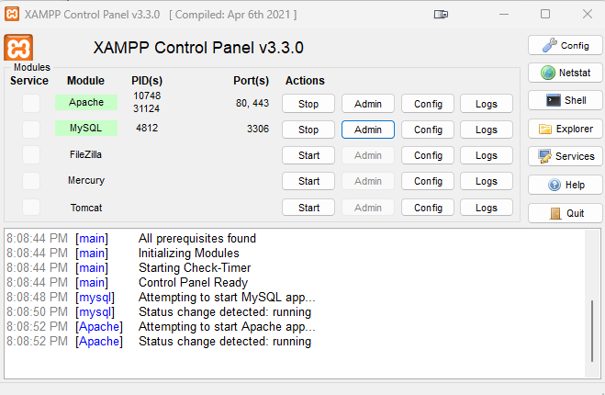
Run Apache and MySQL

Slide 46
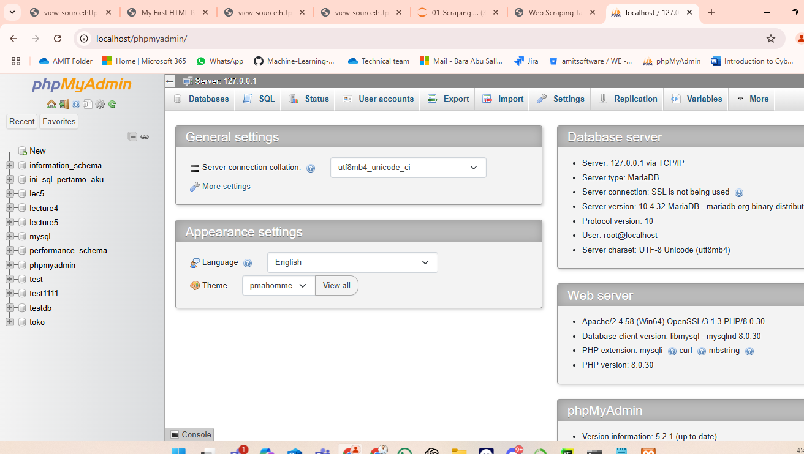

Slide 47
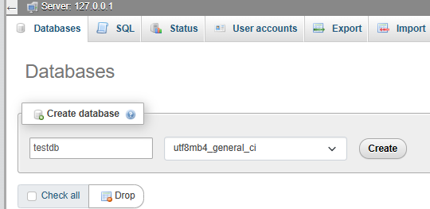
Create Database (testDB)
1
2
3

Slide 48
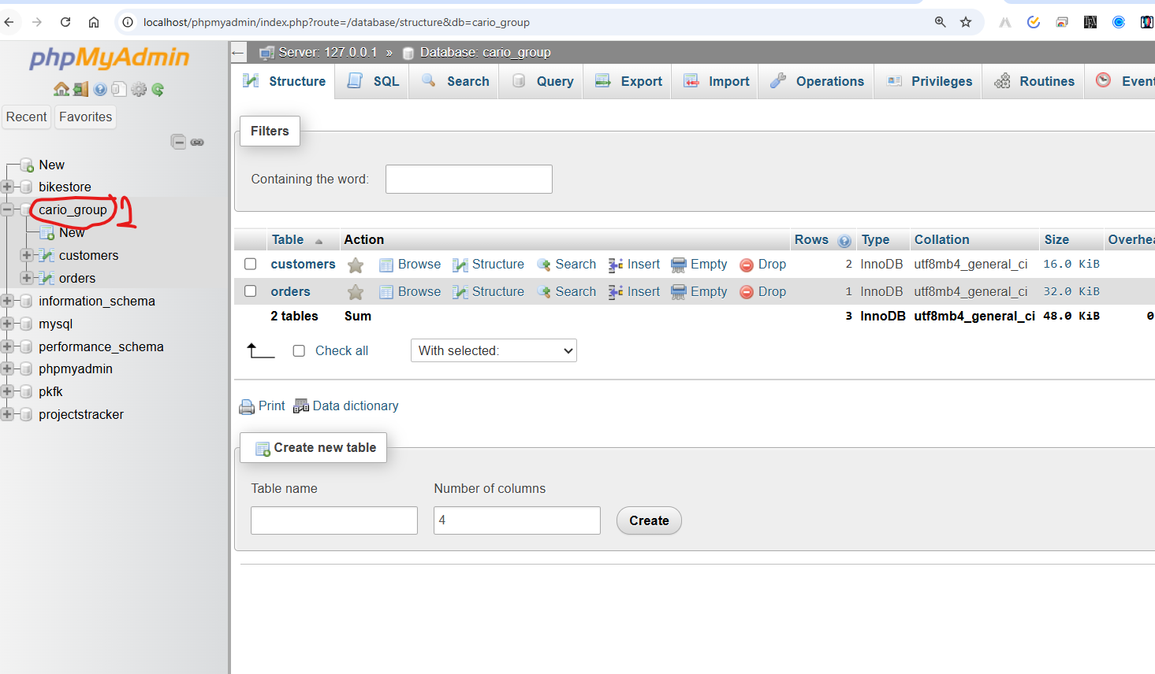

Slide 49
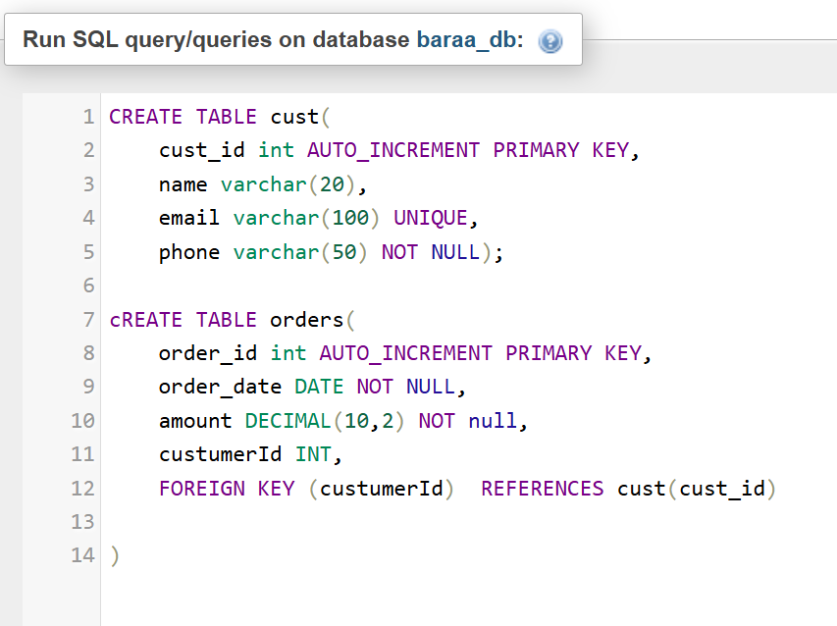

Slide 51
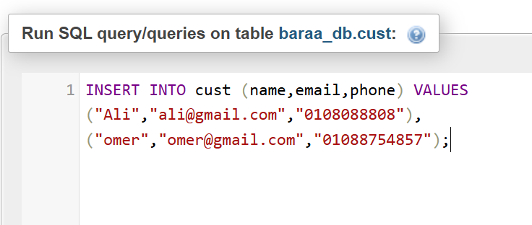
insert into customers
insert into orders

